Slide 1
Risk measurement for portfolios in Fixed-income and Currency markets
Christian Carmona
STAT 222 Midterm Presentation
March 19, 2014

Slide 2
Research question and Audience
Introduction
Objective and Audience
Estimate the maximum loss generated by fluctuation in market prices for a portfolio comprised with Fixed-Income instruments and spot position in several foreign currencies.
Portfolio managers, Investors, Investment banks, regulators and general public with interest to invest in the fixed-income and currency markets.

Slide 3
Data set
Implementation
Data Set
Treasury Yield Curve Rates
Source: US Department of treasury, Resource Center http://www.treasury.gov/resource-center
Daily quotes with the yield-to-maturity rates for terms covering: 3m, 6m, 1y, 2y,5y,…,30y
A xml file for each year 2006-2014
Data located in label text
Foreign Exchange Rates
Source: US Federal Reserve, data download program http://www.federalreserve.gov/datadownload
Daily exchange rates for most of the currencies in the world.
Zip file containing one xlm file for historical data
Data nested inside label attributes

Slide 4
Implementation
Algorithm Flow Diagram
Portfolio specification
Load instruments information
Identification of risk factors
Identify portfolio’s exposure
Obtain historical information
Portfolio valuation under current prices
Estimation of model parameters:
E(R_{i}), Cov_{t}(R_{i},R_{j})
Simulation of risk factors
Portfolio valuation under simulated scenarios
Profit & Losses
Distribution
Market Risk Measures:
VaR , CVaR

Slide 5
Risk Model
Implementation
Risk Model
Portfolio Exposures
S
Risk Factors stochastic dynamics
S

Slide 6
IPython notebook implementation
Implementation
IPython Notebook
This project implemented RiskMetrics methodology in IPython notebook.
Data Loading
Portfolio loading
Simulation of risk factors (scenarios)
Cash flows identification
Portfolio Valuation
P&L calculation
Estimation of Value-at-Risk
Back testing
Benefits
Indexing properties
Time Series attributes
Problems
Visualization of big data frames
Plotting customization

Slide 7
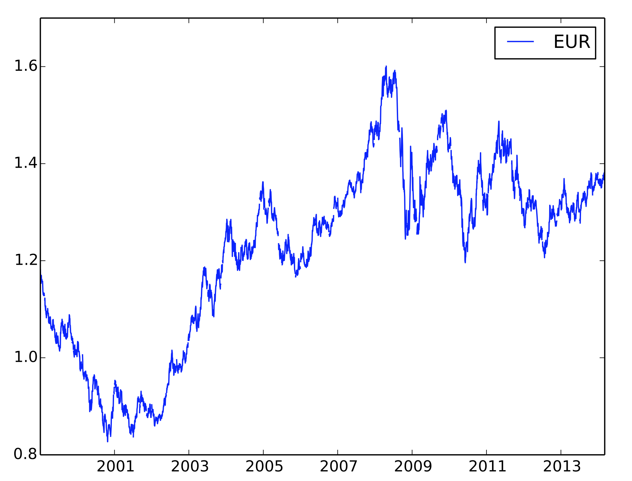
Currencies
Results
Historical Data

Slide 8
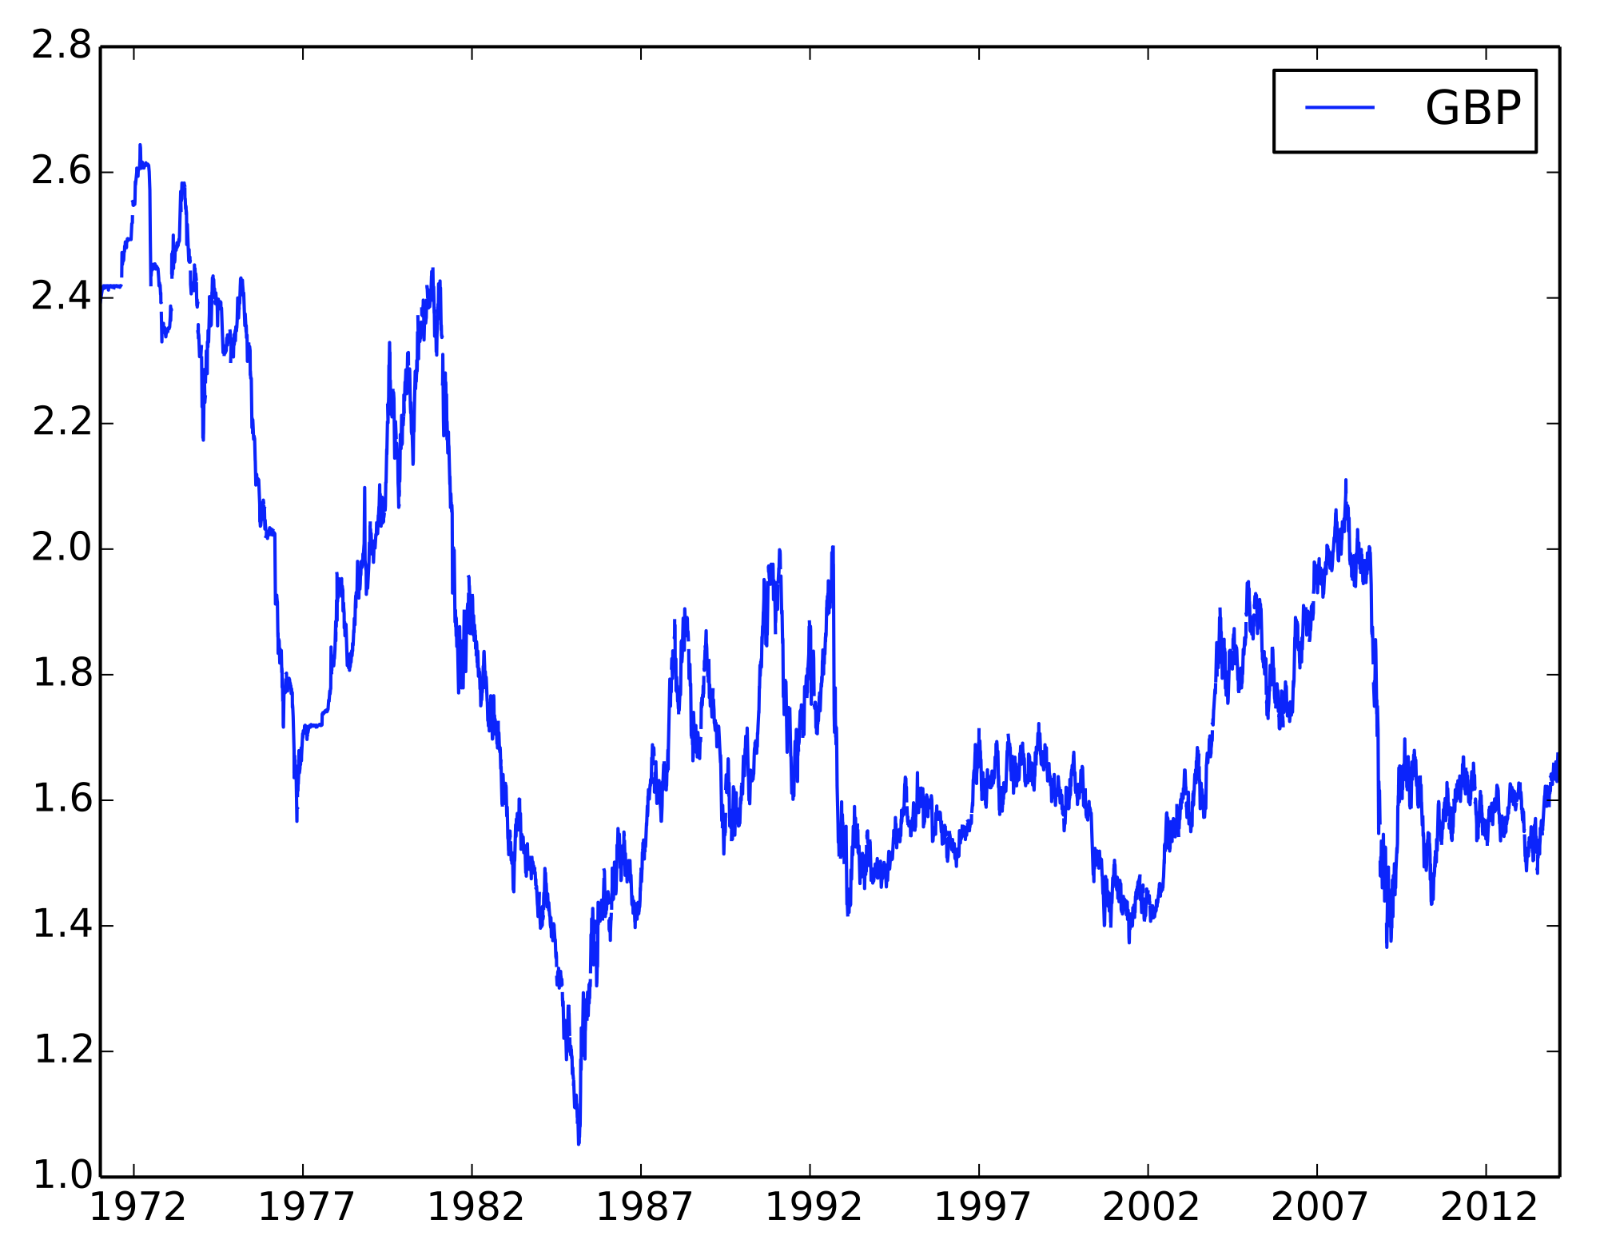
Currencies
Results
Historical Data

Slide 9
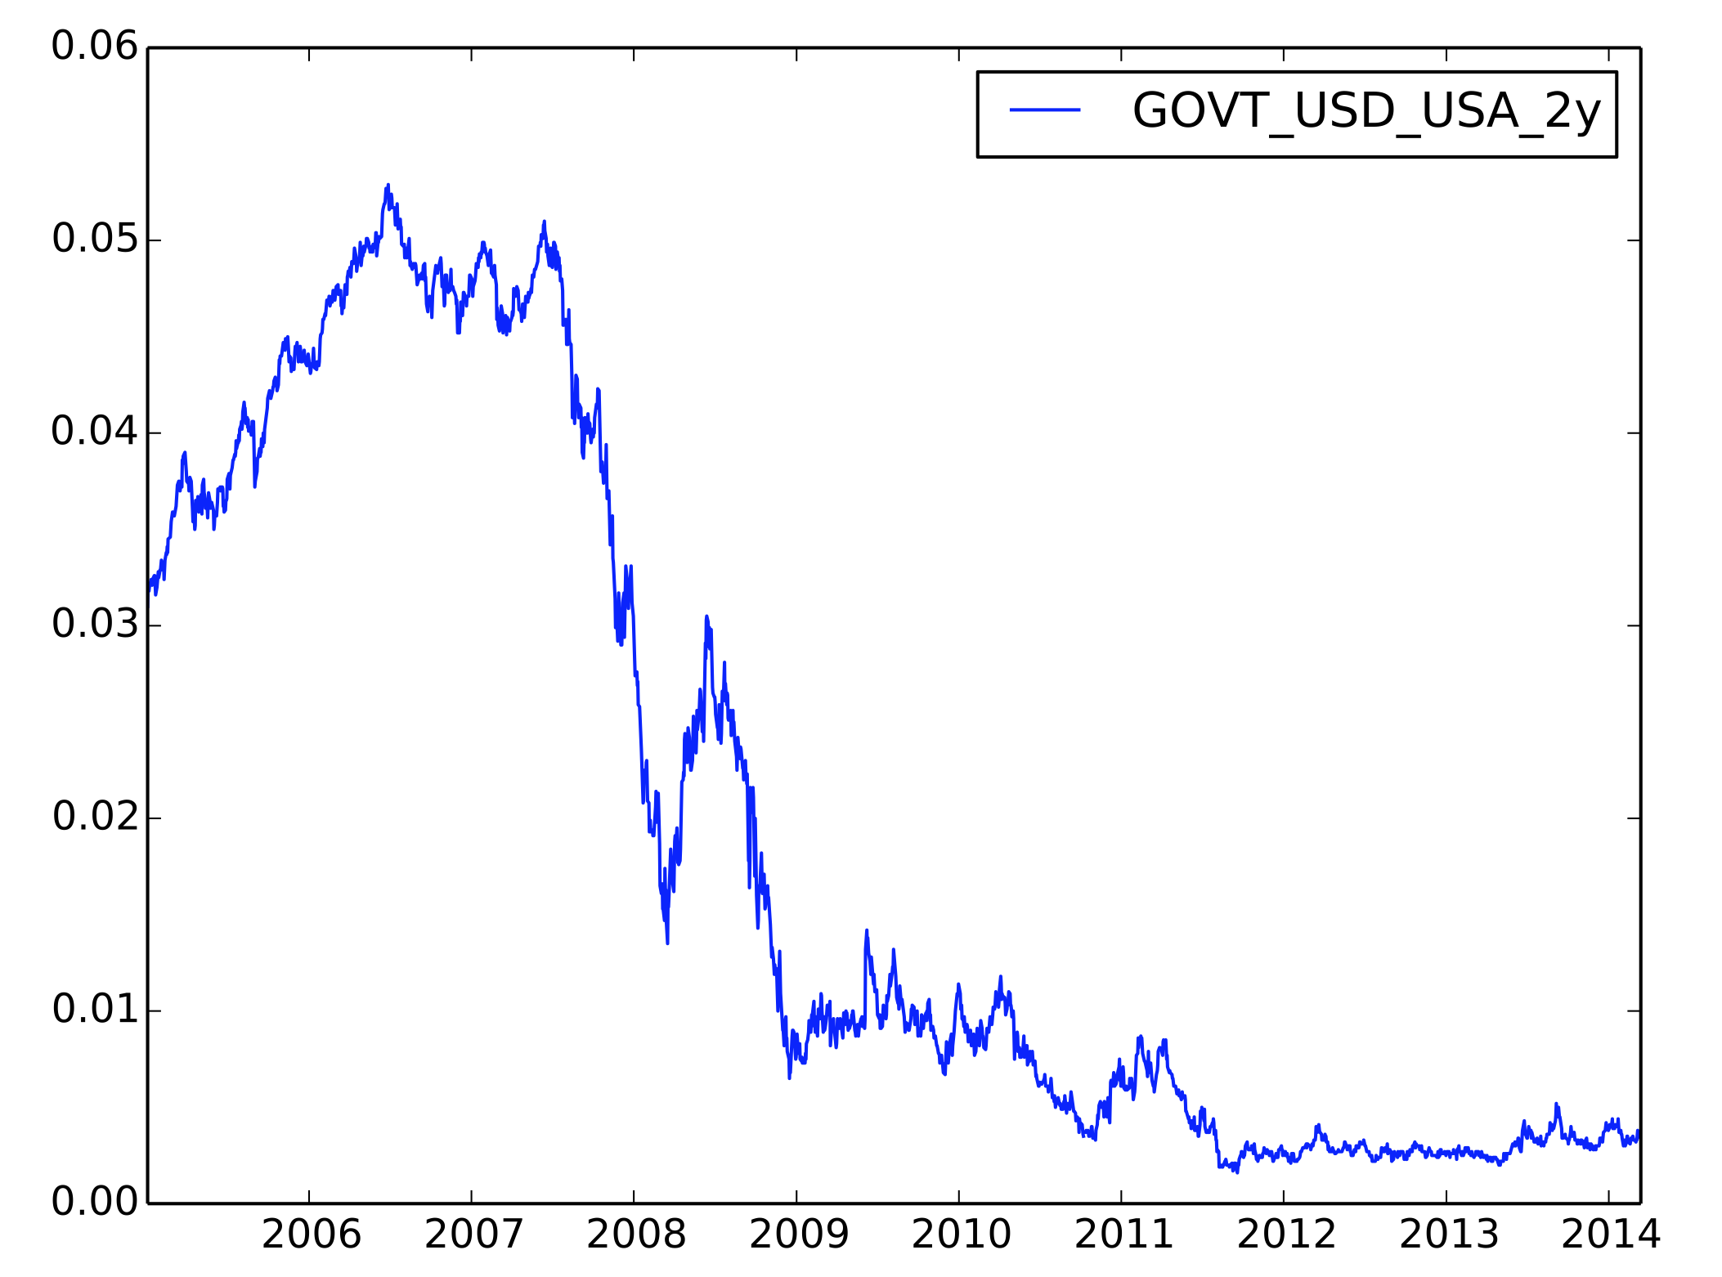
Treasury Rates
Results
Historical Data

Slide 10
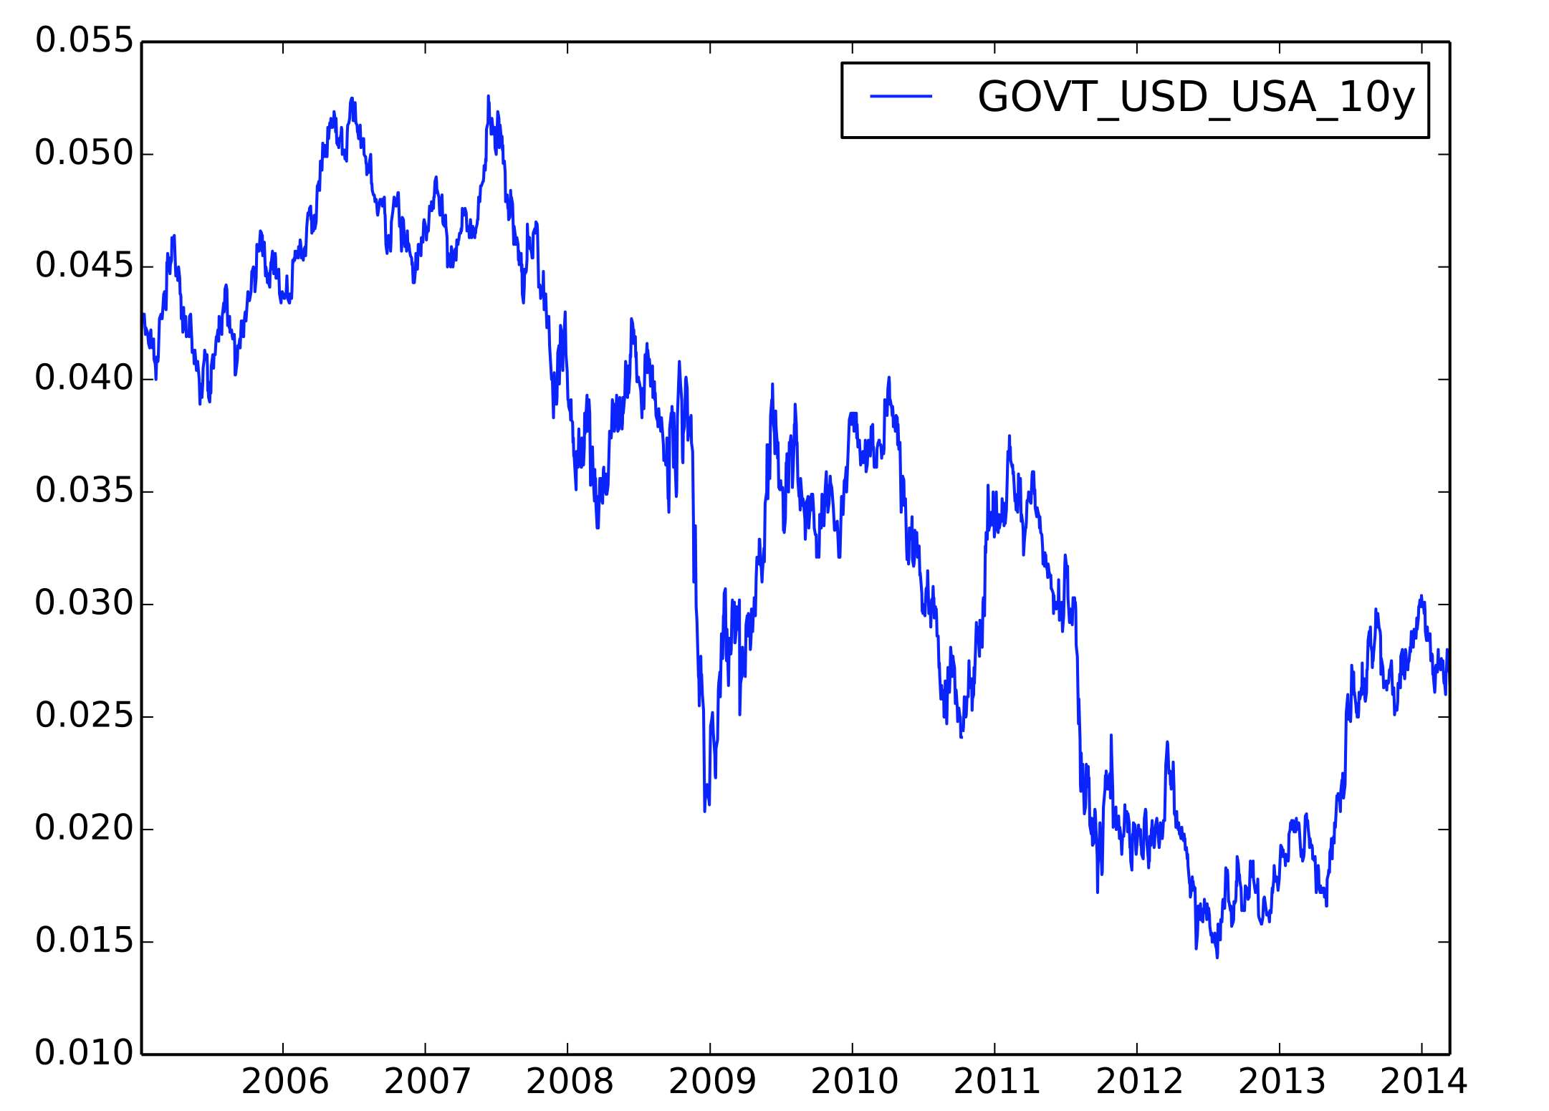
Treasury Rates
Results
Historical Data

Slide 11
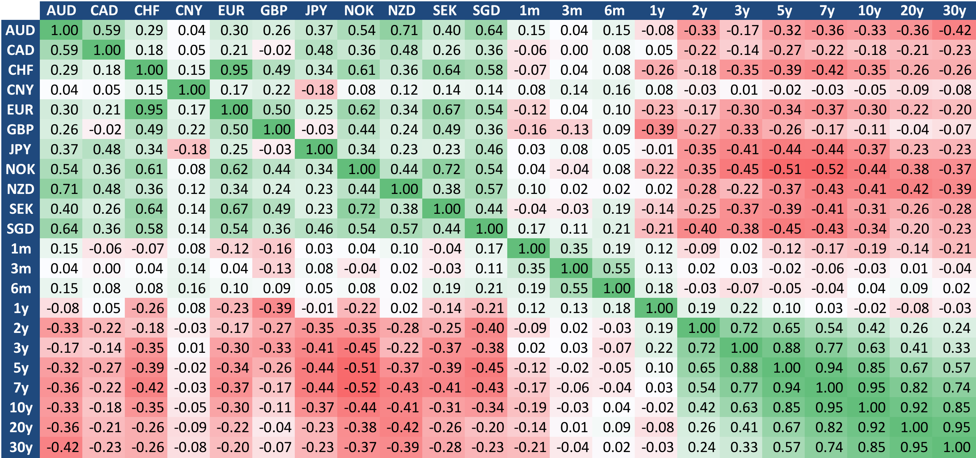
Correlation estimation
Results
Covariance

Slide 12
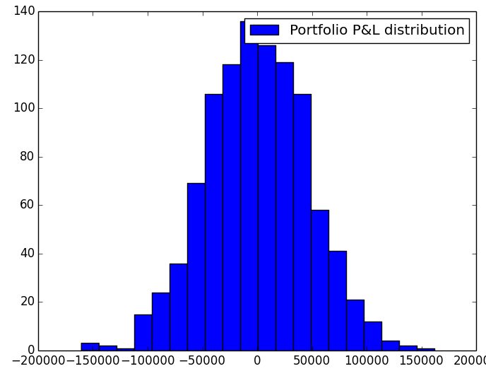
Value-at-Risk Estimation
Results
VaR estimation
Level (%) | Portfolio Value-at-Risk (USD)
90 | 60,336
95 | 74,573
97.5 | 92,676
99 | 106,956

Slide 13
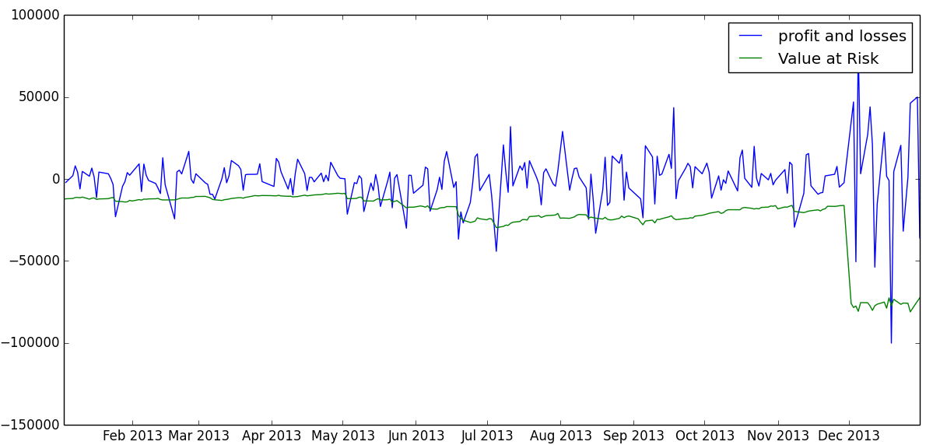
Backtesting
Backtesting
2013

